Slide 1
Casting Geometric Toolsuite
State of the Art – 22 July 2019
Results produced using code available online at: https://github.com/wwarriner/casting_geometric_toolsuite via commit tagged v0.3.0.
Please cite https://doi.org/10.1007/s40962-017-0167-2
Visualizations courtesy of ParaView (https://www.paraview.org/)

Slide 2
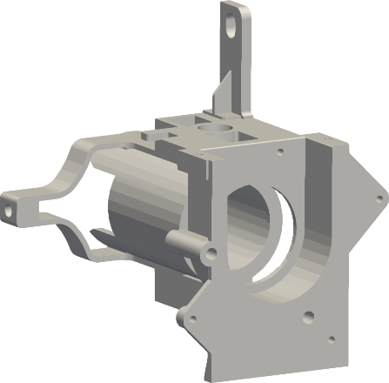
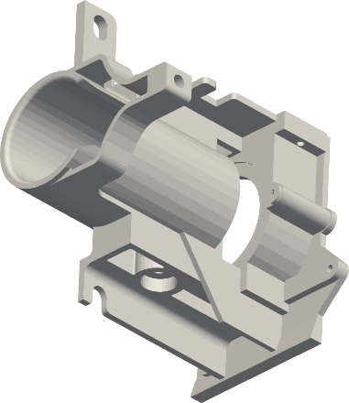
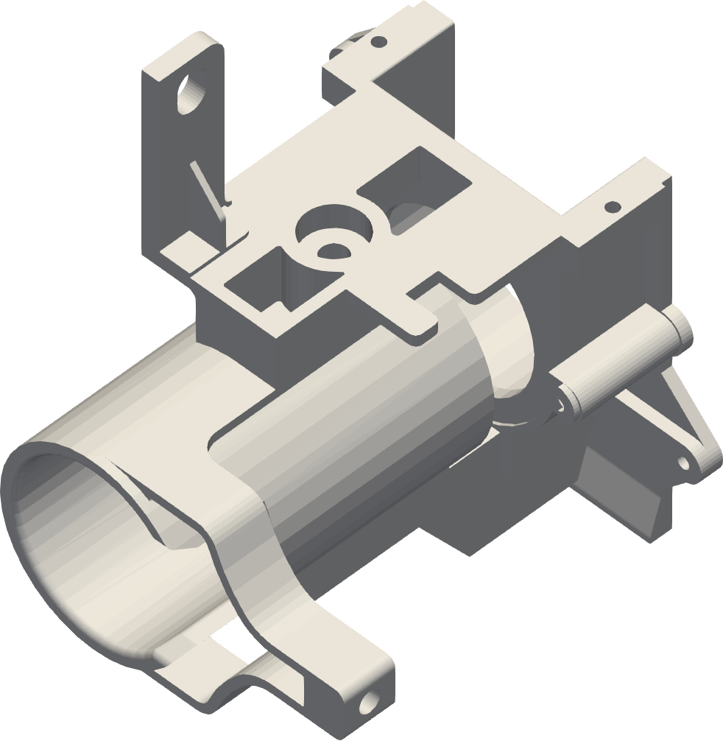
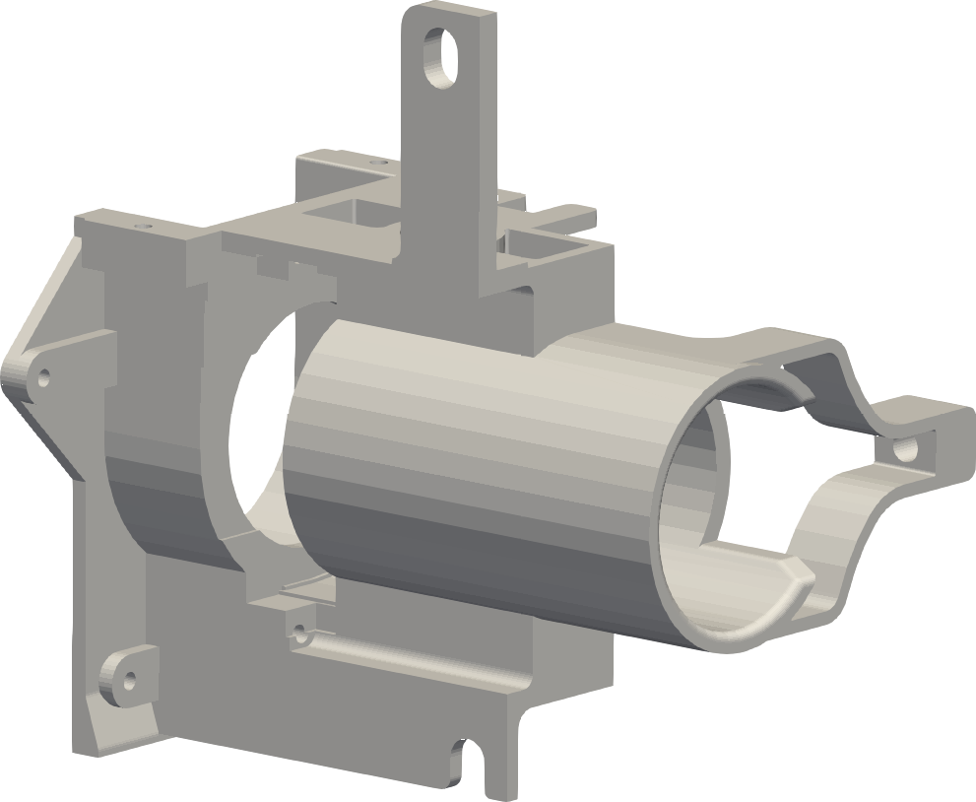
Demonstration geometry
Steering column mount
(https://grabcad.com/library/steering-column-mount-1)

Slide 3
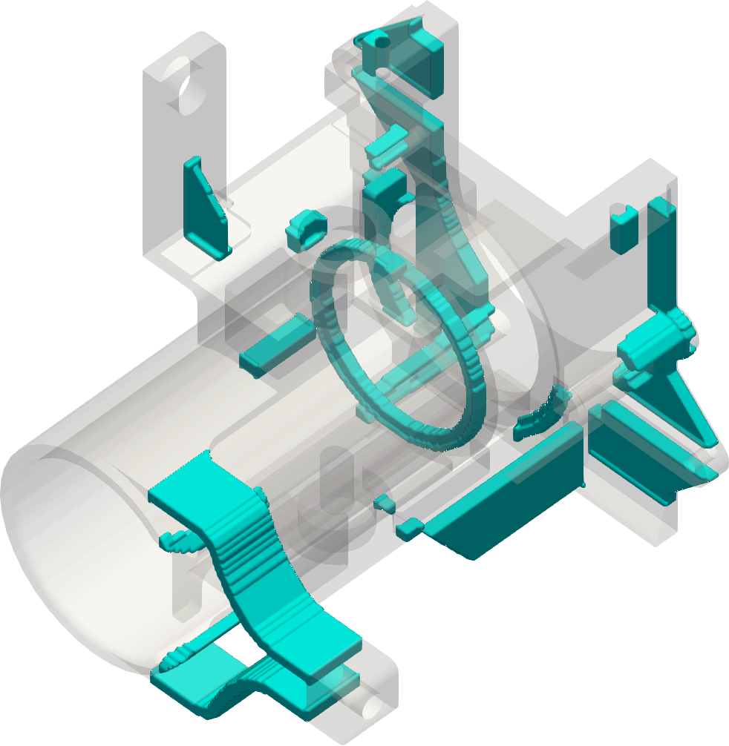
Cavity thin wall regions
Steering column mount
(https://grabcad.com/library/steering-column-mount-1)

Slide 4
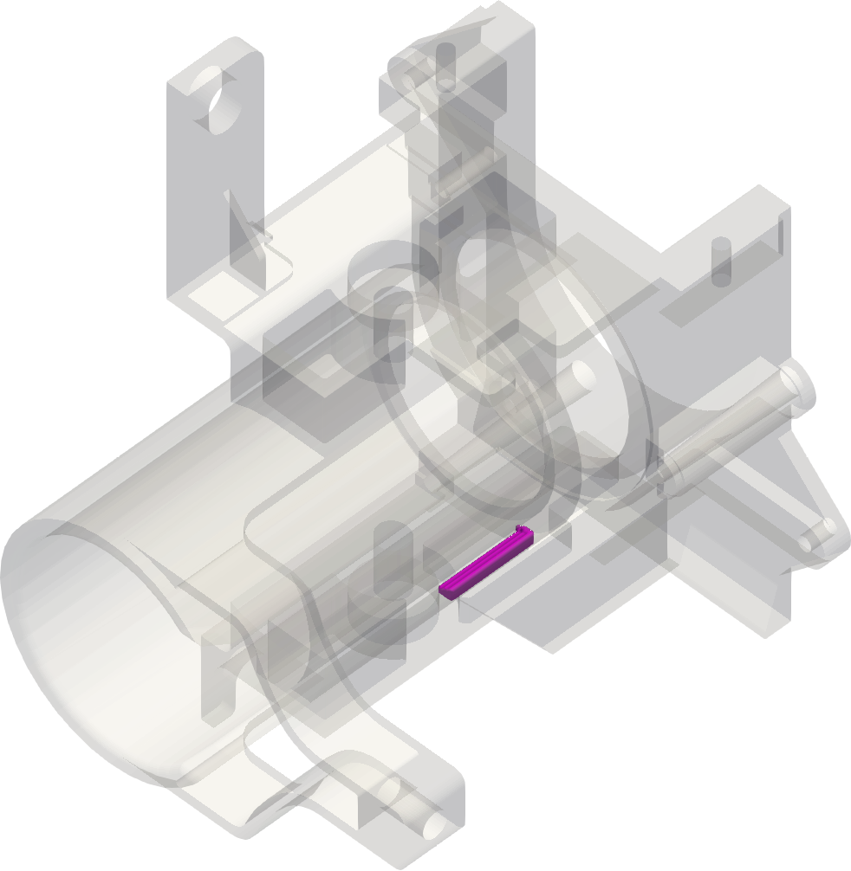
Mold thin wall regions
Steering column mount
(https://grabcad.com/library/steering-column-mount-1)

Slide 5
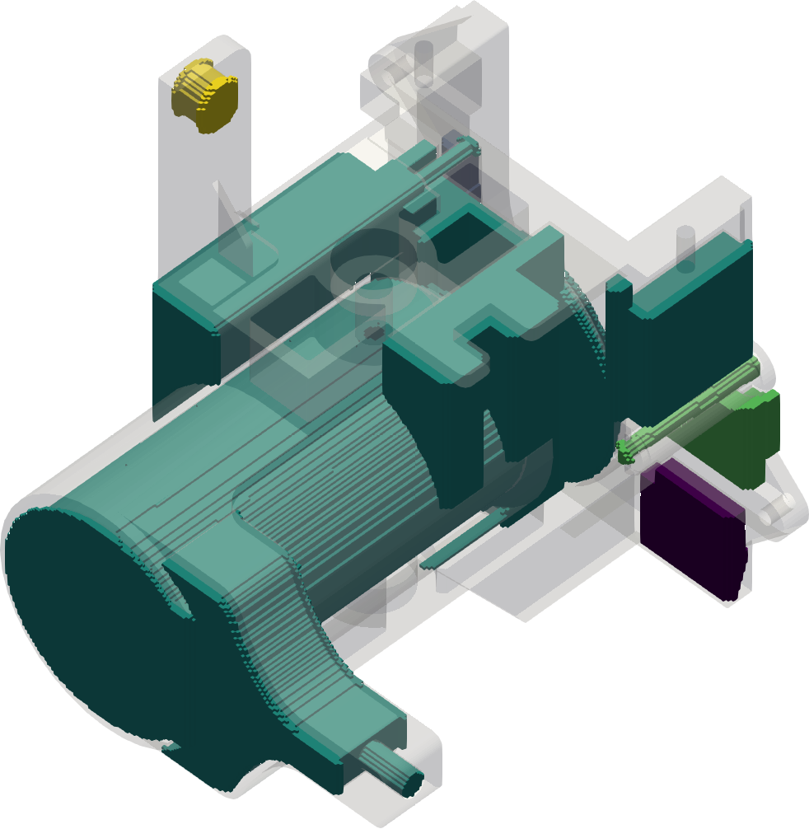
Undercuts
Parting direction
Steering column mount
(https://grabcad.com/library/steering-column-mount-1)

Slide 6
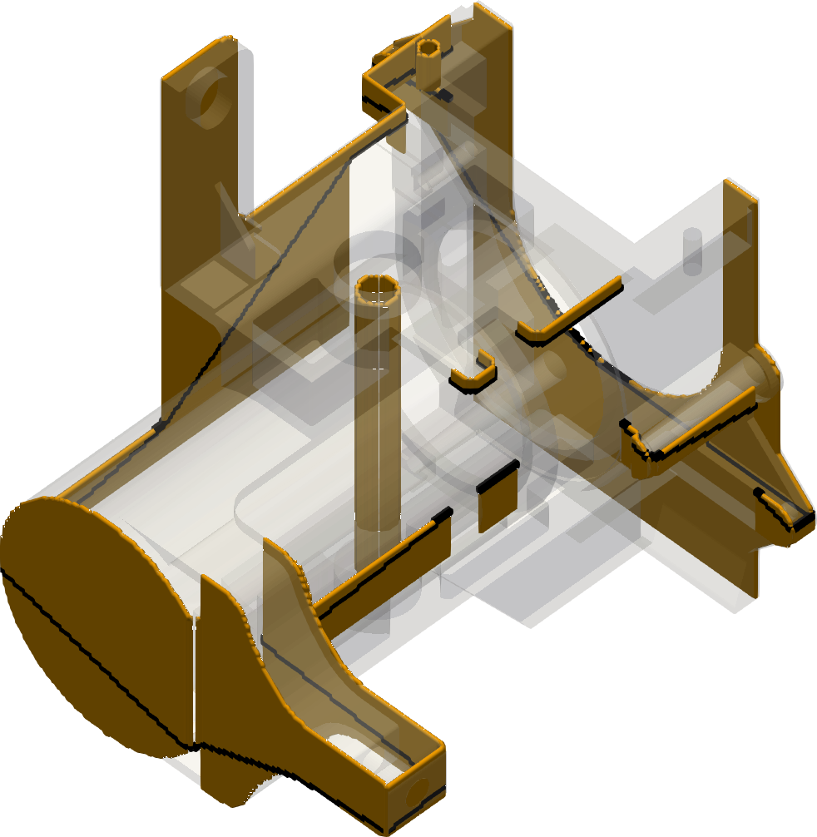
Parting Line
Parting direction
Most-extreme set of parting lines in orange
Steering column mount
(https://grabcad.com/library/steering-column-mount-1)
Flattest (optimal) parting line in black

Slide 7
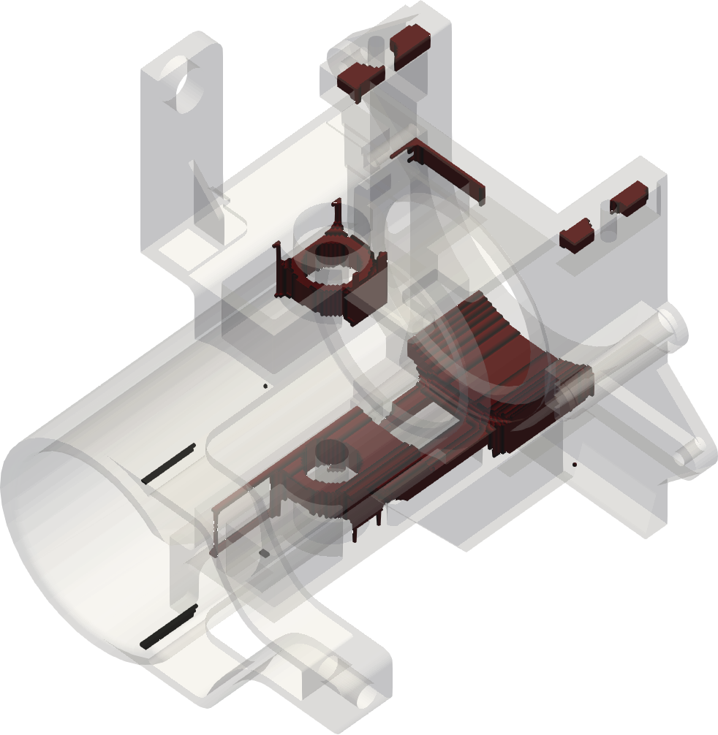
Hotspots
Steering column mount
(https://grabcad.com/library/steering-column-mount-1)
Note these hotspots are geometry-based, not physics-based. We can do physics-based, but the computation time is a little on the long side (~20 times as long)

Slide 8
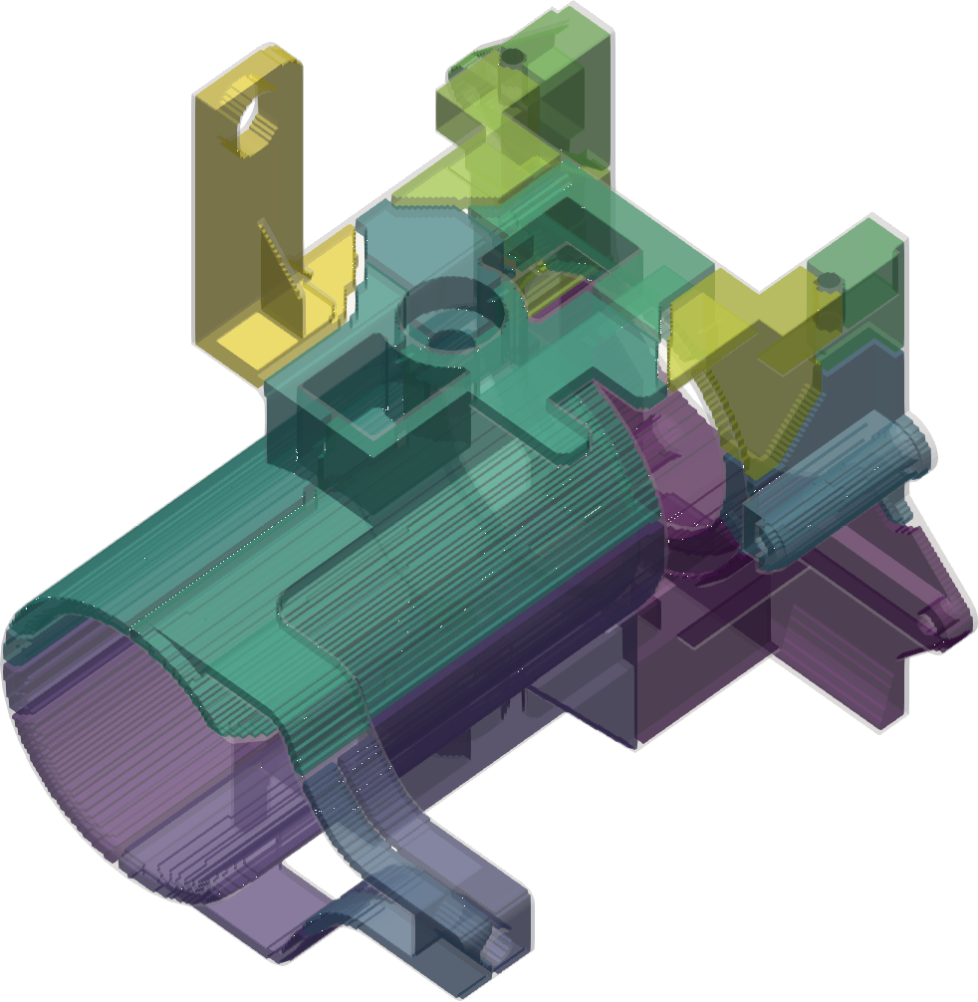
Isolated sections
Steering column mount
(https://grabcad.com/library/steering-column-mount-1)
Isolated sections each have one isolated hotspot or melt. The boundaries between sections indicate where the casting will divide into isolated melts. Note this is based on the geometric hotspots.

Slide 9
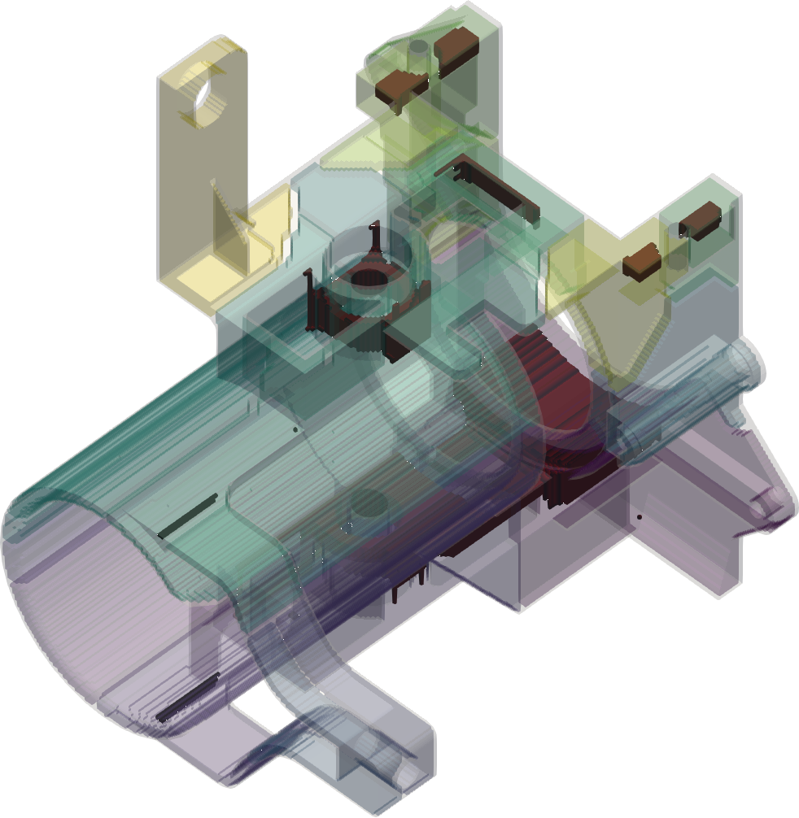
Isolated sections + hotspots
Steering column mount
(https://grabcad.com/library/steering-column-mount-1)
Isolated sections each have one isolated hotspot or melt. The boundaries between sections indicate where the casting will divide into isolated melts. Note this is based on the geometric hotspots.

Slide 10
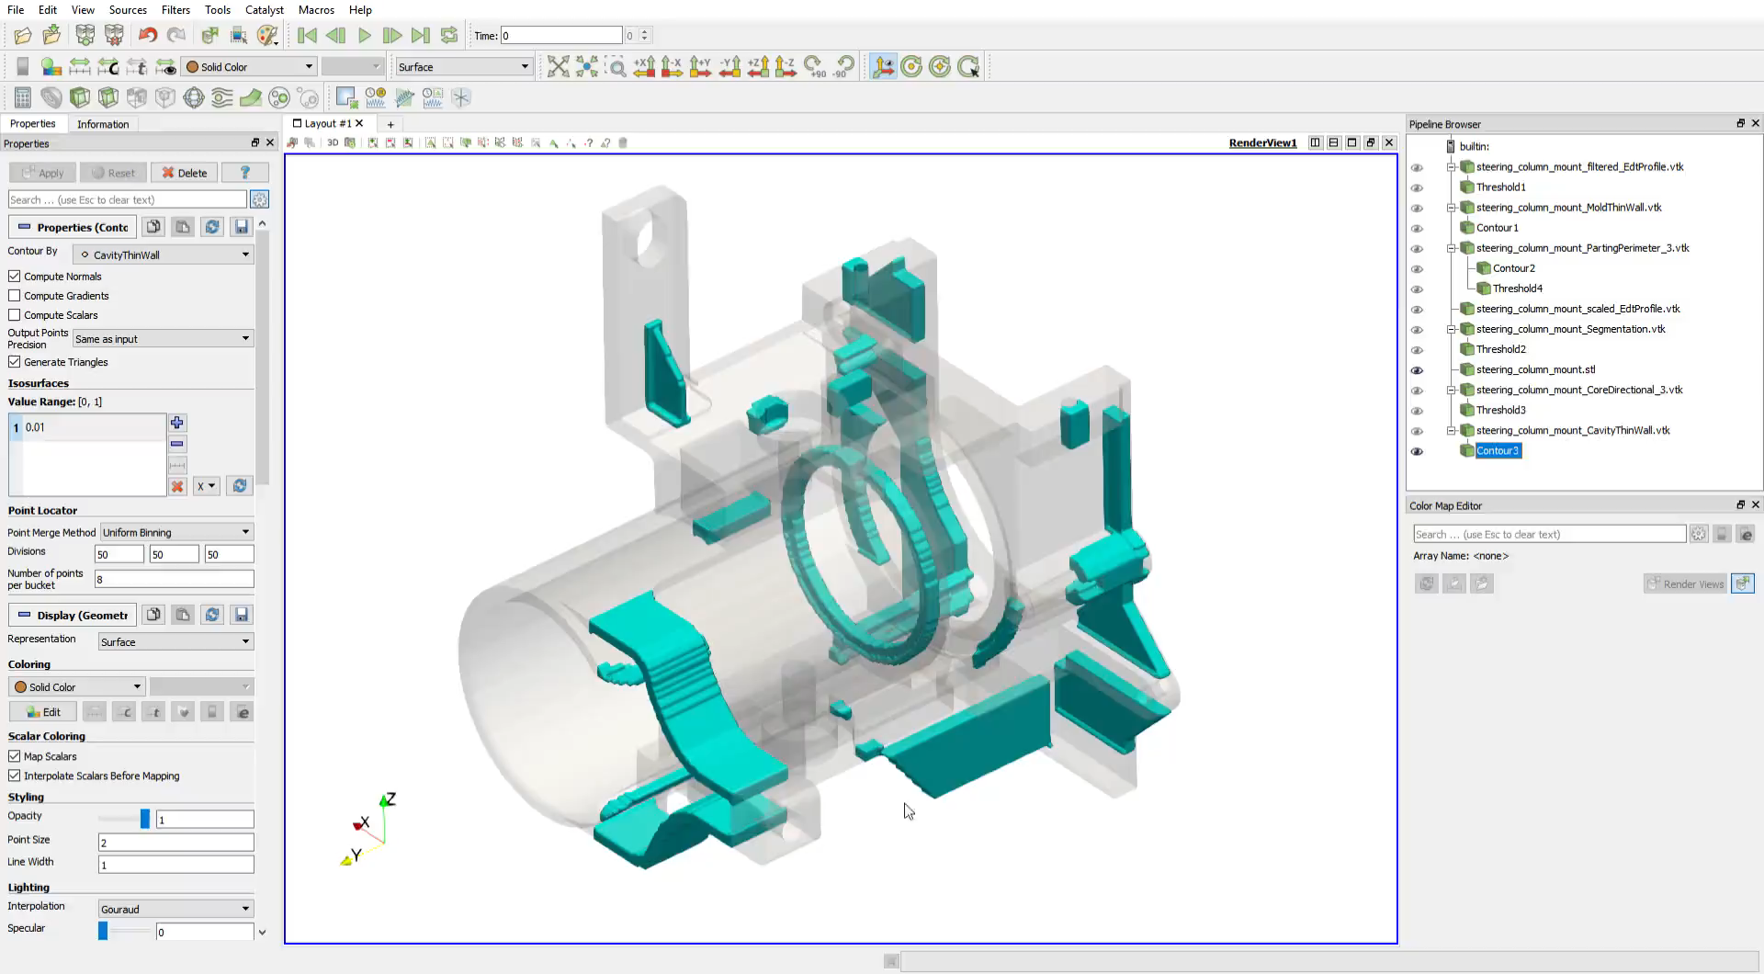
Video demonstration

